Slide 1

Predicting Customer Booking Completion British Airways Data Science Internship – Task 2
By,
Ramya G S

Slide 2
Objective & Approach
Objective
To build a predictive model that identifies which customers are likely to complete a booking, enabling British Airways to proactively target high-value travelers.
Approach
Explored and cleaned customer booking data
Engineered behavioral features (e.g., weekend travel, premium intent)
Trained a Random Forest classifier using an 80/20 train-test split
Evaluated model performance and interpreted feature importance

Slide 3
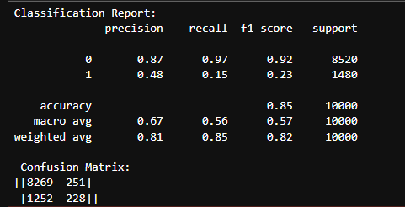
Model Performance & Insights
Model Evaluation
Accuracy: 0.85
Precision: 0.81
Recall: 0.85
F1-score: 0.82
Evaluated using 80/20 train-test split and Random Forest classifier
Key Insights
Premium intent, purchase lead, and length of stay were the most predictive features
Weekend and long-haul travelers showed higher booking completion rates
Customers with multiple preference flags (e.g., meals + seat + baggage) were more likely to convert

Slide 4
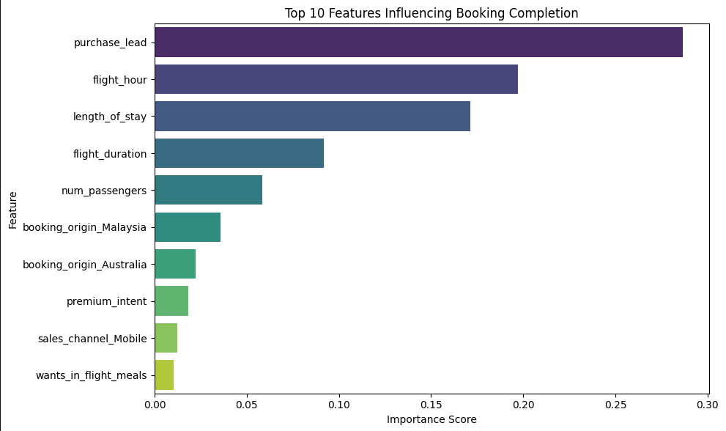
Top 10 features influencing booking completion Based on Random Forest Model Feature Importance

Slide 5
Business Recommendation
Target high-premium-intent customers with tailored offers and loyalty incentives
Prioritize weekend and long-haul travelers for upselling opportunities
Use model predictions to guide personalized marketing and reduce booking drop-offs
Monitor feature trends to refine customer segmentation and campaign timing

